Slide 1


Credit Card Fraud Prediction
Elizaveta Kotikova, Martyna Janina Kopyta, Péter Ferenc Gyarmati

Slide 2

Challenge
Why is it challenging?
What simplifies the analysis?
No domain knowledge required
High cost of errors
Fraudsters evolution
Real-Time detection required
Personal data → privacy regulations
Expected benefits of the project:
Reduced financial losses
Increased trust and satisfaction
Enhanced transaction security
Efficient fraud investigation

Slide 3
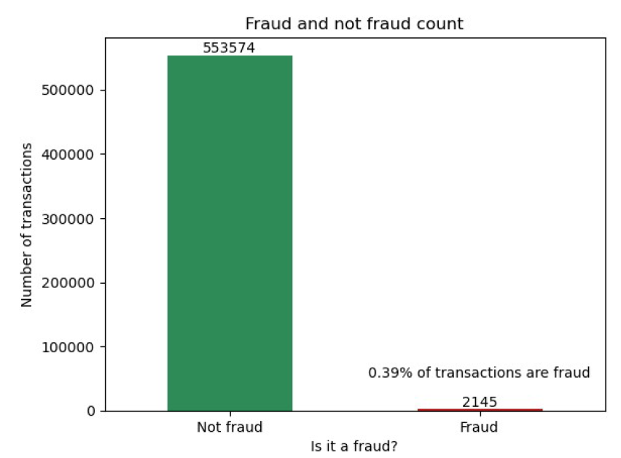

Dataset
555,719 instances
22 attributes
Mix of categorical and numerical data types
No null values
Imbalanced dataset
Timestamp of the transaction • Сustomer id number • Merchant • Category Transaction type • Transaction amount
Cardholder's first and last name• Cardholder‘s address• Latitude and Longitude of cardholder's location
Population of the cardholder's city• Cardholder's date of birth• Unique transaction id• Transaction timestamp
Latitude and Longtitude of merchant's location • Fraudulent transaction indicator • Cardholder's job title

Slide 4
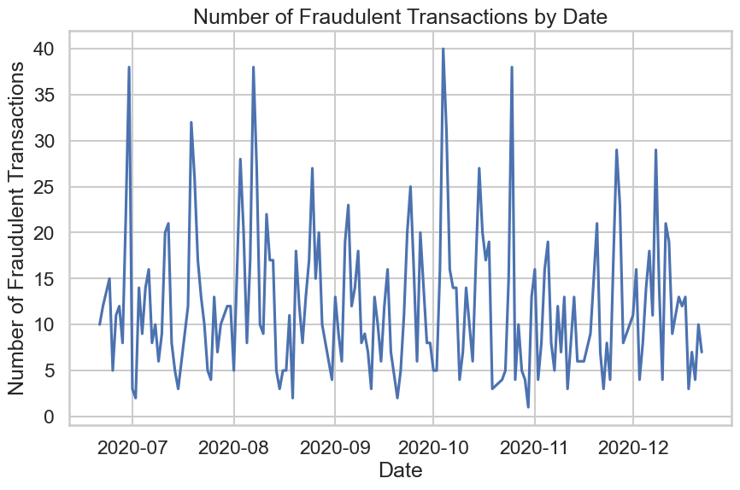
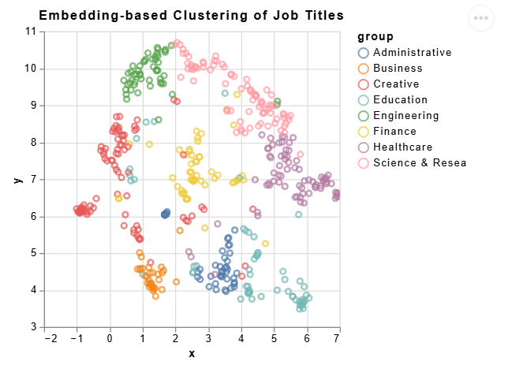
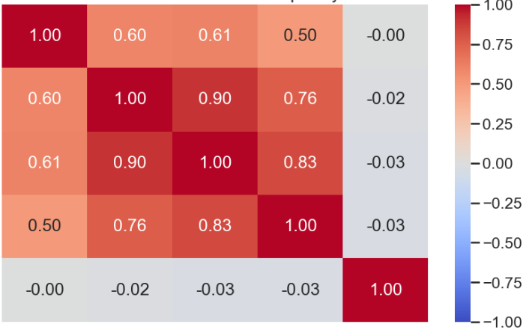
Data Understanding and Preparation
Correlation between Transaction Frequency and Fraud
Tr.* per Day
Tr. per Week
Tr. per 2 Weeks
Tr. per Month
Is Fraud
Tr.* per Day
Tr. per Week
Tr. per 2 Weeks
Tr. per Month
Tr. per Month
Data Preparation
Feature Engineering
Time-based features
Transaction Features
Customer Features
Data Cleaning
Hour of Day
Day of Week
Is Weekend
Amount
Log Amount
Distance from Merchant
Age
City Population
Data Validation
Gender

Slide 5
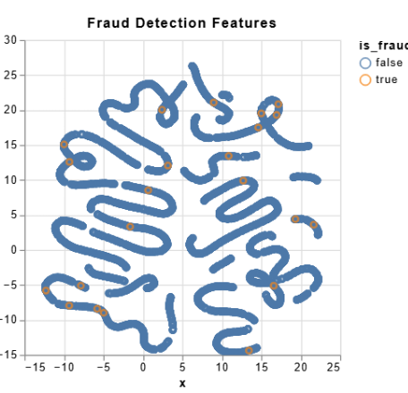

Modelling
Clustering
Classification
Visualization of prepared features in two-dimensional space using UMAP.
Exploration with KMeans, DBSCAN, and agglomerative hierarchical clustering.
None were effective in distinguishing fraudulent transactions from legitimate ones.
3 datasets: original, SMOTE-oversampled, and NearMiss-undersampled.
Training of decision tree and random forest classifiers.
→ 6 models with varying Class-wise Performance.
Training
Sampling
Models
Original Data
SMOTE Oversampling
NearMiss Undersampling
Random Forest
Decision Tree

Slide 6
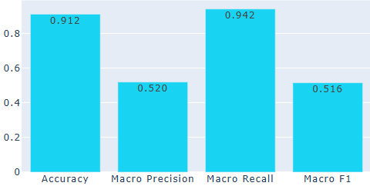
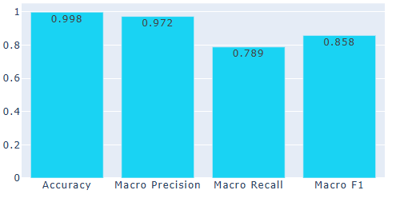
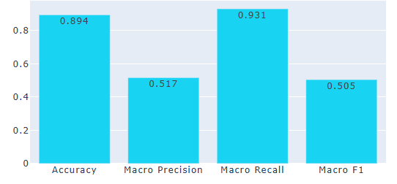
Results
Random Forests: higher precision.
Decision Trees: simpler, faster, task-dependent.
SMOTE: improves recall by reducing false negatives.
NearMiss: balances errors, higher fraud detection with more false positives.
NearMiss-undersampling, random forest
SMOTE-oversampling, decision tree
NearMiss-undersampling, decision tree

Slide 7
Conclusion
Clustering
Classification
Explored KMeans, DBSCAN, and hierarchical clustering—none effectively distinguished fraud.
→ Shifted to supervised learning.
Random Forest or Decision Tree trained on the undersampled dataset with NearMiss might be a better choice.
Trade-off: NearMiss-undersampling excels in fraud detection but increases false alarms—key for credit card companies to weigh.

